Slide 1




5CLCsCan
G gle
VERSION 1.3.1

Slide 2


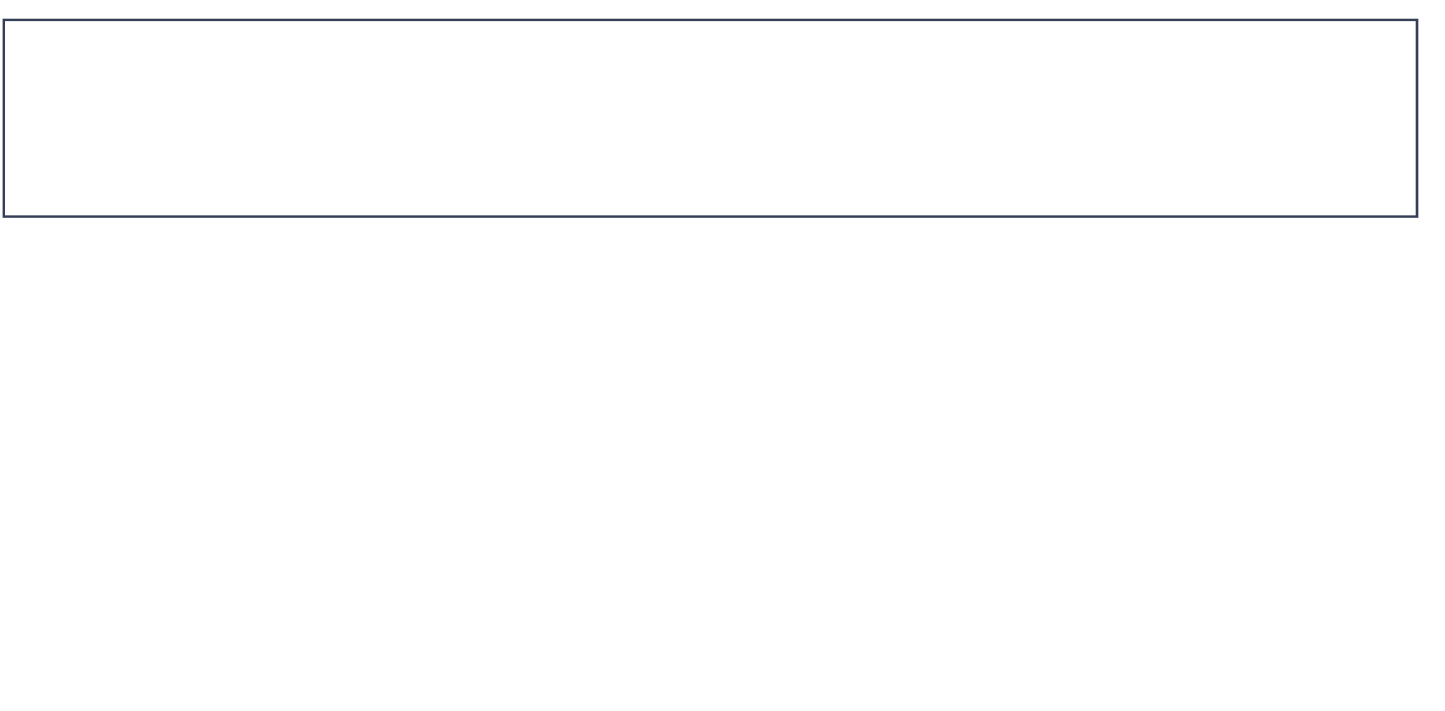
5CLCsCan
OVERVIEW
Gogle platform provide a trip planning recommendations and exploration experience within Ho Chi Minh City.
PROJECT MANAGEMENT
RESPONSIBILITY
PROBLEM STATEMENT
PRODUCT POSITION
USERS
MARKETS
USE CASE MODEL
NON-FUNC REQUIREMENTS
ARCHITECTURE
PACKAGE DIAGRAM
DESIGN UI
SOFTWARE TESTING

Slide 3






5CLCsCan
TEAM MEMBERS
Le Duy Anh
Cao Huu Khuong Duy
22127012
22127083
Back-end Developer
Data Engineer
Tester
PROJECT MANAGEMENT
Ly Dinh Minh Man
Vo Nguyen Phuong Quynh
22127255
21127039
Front-end Developer
Tester
UI Designer
Front-end Developer
Huynh Cao Tuan Kiet
221272219
Project Manager
Back-end Developer

Slide 4
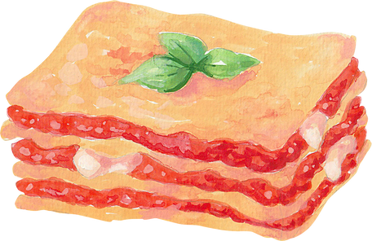
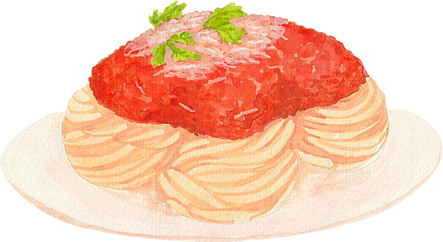


5CLCsCan
RESPONSIBILITY
Le Duy Anh
Cao Huu Khuong Duy
Responsible for spearheading the development of server-side software (back-end) and fulfilling the role of a business analyst within the project. The duties of the Back-end Developer encompass constructing server-side logic, establishing search engine functionality, and guaranteeing alignment with the customer's requirements.
Responsible for data engineering and conducting tests to guarantee the quality and performance of the application, the role of a Data Engineer/Tester encompasses tasks such as constructing the database, integrating server-side logic, and executing both functional and performance evaluations on the application.

Slide 5




RESPONSIBILITY
5CLCsCan
Huynh Cao Tuan Kiệt
Responsible for project management and back-end development. His task includes meticulous planning, making strategic decisions, and delegating tasks to ensure that the project progresses smoothly and efficiently. He plays a pivotal role in defining the primary concept for the recommendation system, ensuring that it aligns with the project’s goals and objectives.
Ly Dinh Minh Man
Vo Nguyen Phuong Quynh
Responsible for developing the user interface
and ensuring application quality, the tasks of the
Front-end Developer/Tester encompass constructing engaging, developing platform’s interfaces and interactive user interfaces while conducting UI and performance testing of the application.
Responsible for developing the user interface and
designing visually appealing interfaces for the
application. The tasks of the Front-endDeveloper/UI Designer include building attractive and interactive user interfaces, ensuring a good user experience, and integrating design requirements into the product.

Slide 6


POSITIONING
5CLCsCan
THE PROBLEM OF
Problem Statement
Difficulty in discovering new and interesting places to hang out for resident. The sheer volume of options, coupled with mistrust in online reviews and limited marketing from local businesses, makes it challenging for them to find spots that truly resonate with their preferences. This can lead to a stagnant social life and missed opportunities to explore vibrant local venues.

Slide 7



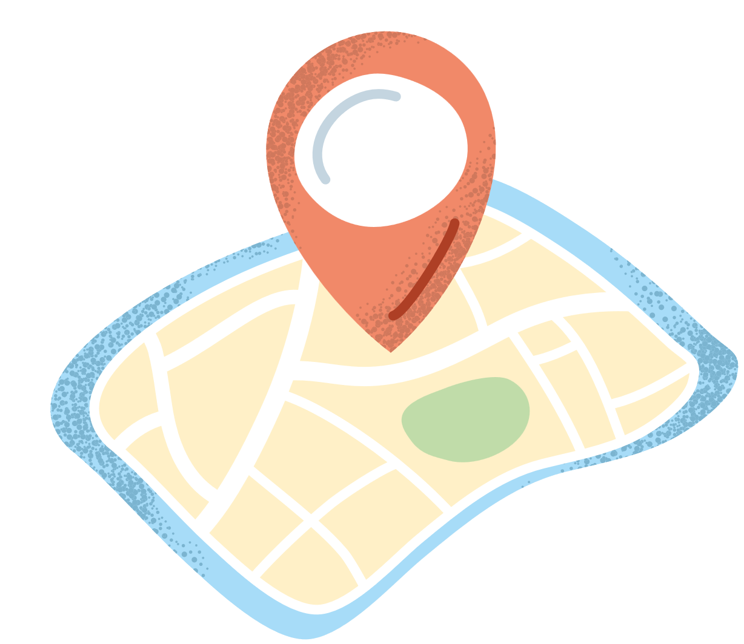
POSITIONING
5CLCsCan
FOR
Product Position Statement
residents of Ho Chi Minh City
newcomers to Ho Chi Minh City
travel enthusiasts and planners
.
WHO
want to discover new and interesting places to meet friends and family
need an easy and efficient way to navigate and explore the city
seek a user-friendly and efficient way to organize their trips within Ho Chi Minh City

Slide 8

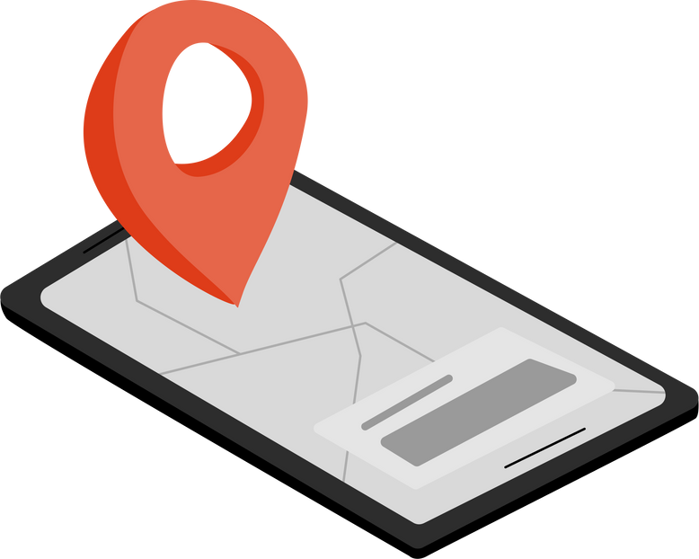


5CLCsCan
Gogle Platform
Gogle.studio
THAT
provides personalized recommendations and highlights hidden gems within the city
integrates maps, weather updates, and local recommendations in one place
combines features such as budget planning, reservation systems, and AI-powered suggestions
UNLIKE
traditional travel websites that offer generic recommendations and lack integrated planning tools
using multiple separate apps for navigation, weather, and travel tips

Slide 9



5CLCsCan
OUR PRODUCT :
offers tailored suggestions that even locals might not know about, making every outing a new adventure
provides a seamless and cohesive experience, simplifying trip planning and enhancing the exploration of the city
delivers a highly customized and integrated planning experience, ensuring users make the most out of their trips
www.reallygreatsite.com

Slide 10


5CLCsCan
MARKET:
Travel and Tourism Market: This market involves tools and services for planning and enhancing travel experiences, including travel apps, booking platforms, and recommendation engines. It caters to travelers and businesses like travel agencies and tour operators, aiming to connect users with personalized travel options.

Slide 11









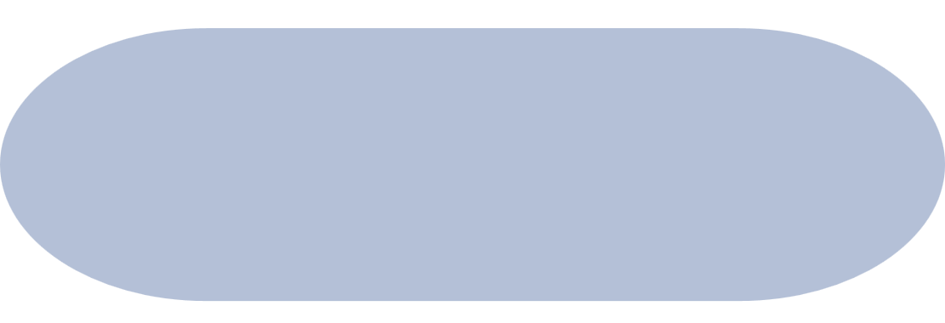




5CLCsCan
Guest
1.Sign up
3. Read Blogs
4. Manage Profile
2.Log in
10. Manage Blog
5. Log out
6. Search places
User
11. Manage Places
7. Create Trip
Admin
12. Manage user accounts
8. Manage trips
9. Write Blogs
<<extend>>
<<extend>>
<<extend>>
View Trip
13. Process user reports
Edit Trip
USE CASE MODEL
Publish Trip Blogs

Slide 12


5CLCsCan
NON-FUNCTIONAL REQUIREMENTS
Applicable standards
The website is designed to function on the latest available version of Google Chrome.
Written: Version 116.0.5845.14 (June 30, 2023) is used as a reference.
Compatibility with other browsers (Microsoft Edge, Opera,…).

Slide 13



5CLCsCan
NON-FUNCTIONAL REQUIREMENTS
SYSTEM STANDARDS
The client-side of the website should use no more than 1GB of RAM.
The client component of the website shall be run on a computer with a graphical screen.
The client interface requires the use of both a mouse and keyboard.
The client component of the website shall run on Windows 10 and Windows 11.

Slide 14


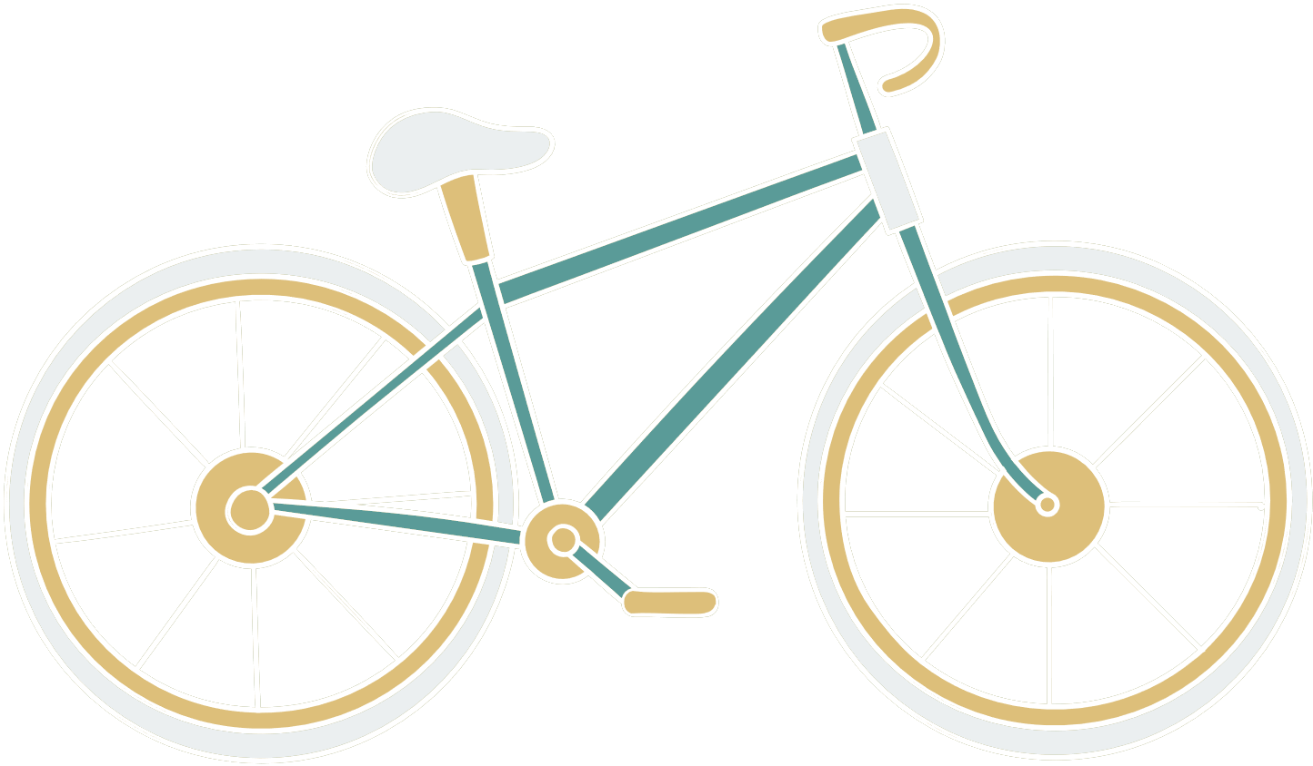
5CLCsCan
NON-FUNCTIONAL REQUIREMENTS
Performance Requirements
The system should be capable of supporting 50 concurrent users on the main server.
The response time of the service should not exceed 10 seconds.
Any transaction should be fully processed within 1 minute after the user confirms the action.

Slide 15


5CLCsCan
NON-FUNCTIONAL REQUIREMENTS
DOCUMENTATION REQUIREMENTS
Permit on online business (following the Digital Business law of 01/2021/NĐ-CP by the Vietnamese Government)
ADDITIONAL REQUIREMENTS
Security: Ensure that all user data is securely encrypted using AES-256 standards.
Availability: The website should achieve an uptime of at least 99.9%.
Usability: The interface must be both responsive and accessible, meeting the guidelines of WCAG 2.1.
Scalability: The platform must be designed to allow horizontal scaling to support an increasing number of users.

Slide 16





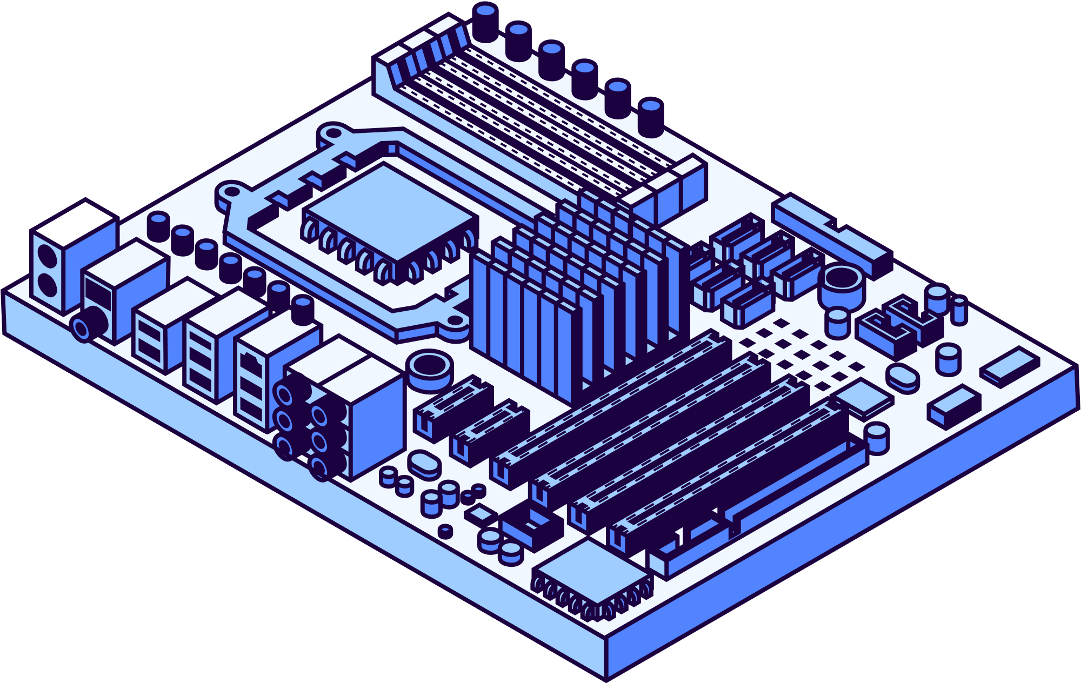





5CLCsCan
ARCHITECTURE AND CONSTRAINTS
Technology
Data
Model
NextJS, Tailwind, MongoDB.
Using the MongoDB database and MongoDB Full text search.
Using the MVC pattern.
Environment
Easy to use
Used for web environment, supports most browsers.
Friendly interface, users can get used to it after the first few minutes of use

Slide 17







Server
PACKAGE DIAGRAM
Front end
View
Back end
App.tsx
Header.tsx
Footer.tsx
HomePage.tsx
AllTripPage.tsx
TripDetailPage.tsx
LoginPage.tsx
SignupPage.tsx
CreareTripPage.tsx
ProfilePage.tdx
EditProfilePage.tsx
MapElement.tsx
Controller
Model
Database
AuthController
TripController
PlaceController
CategoryController
SearchController
User
Category
Trip
Place
Collection
Trip
User
Places
Category
Full-text search
Client browser
5CLCsCan

Slide 18
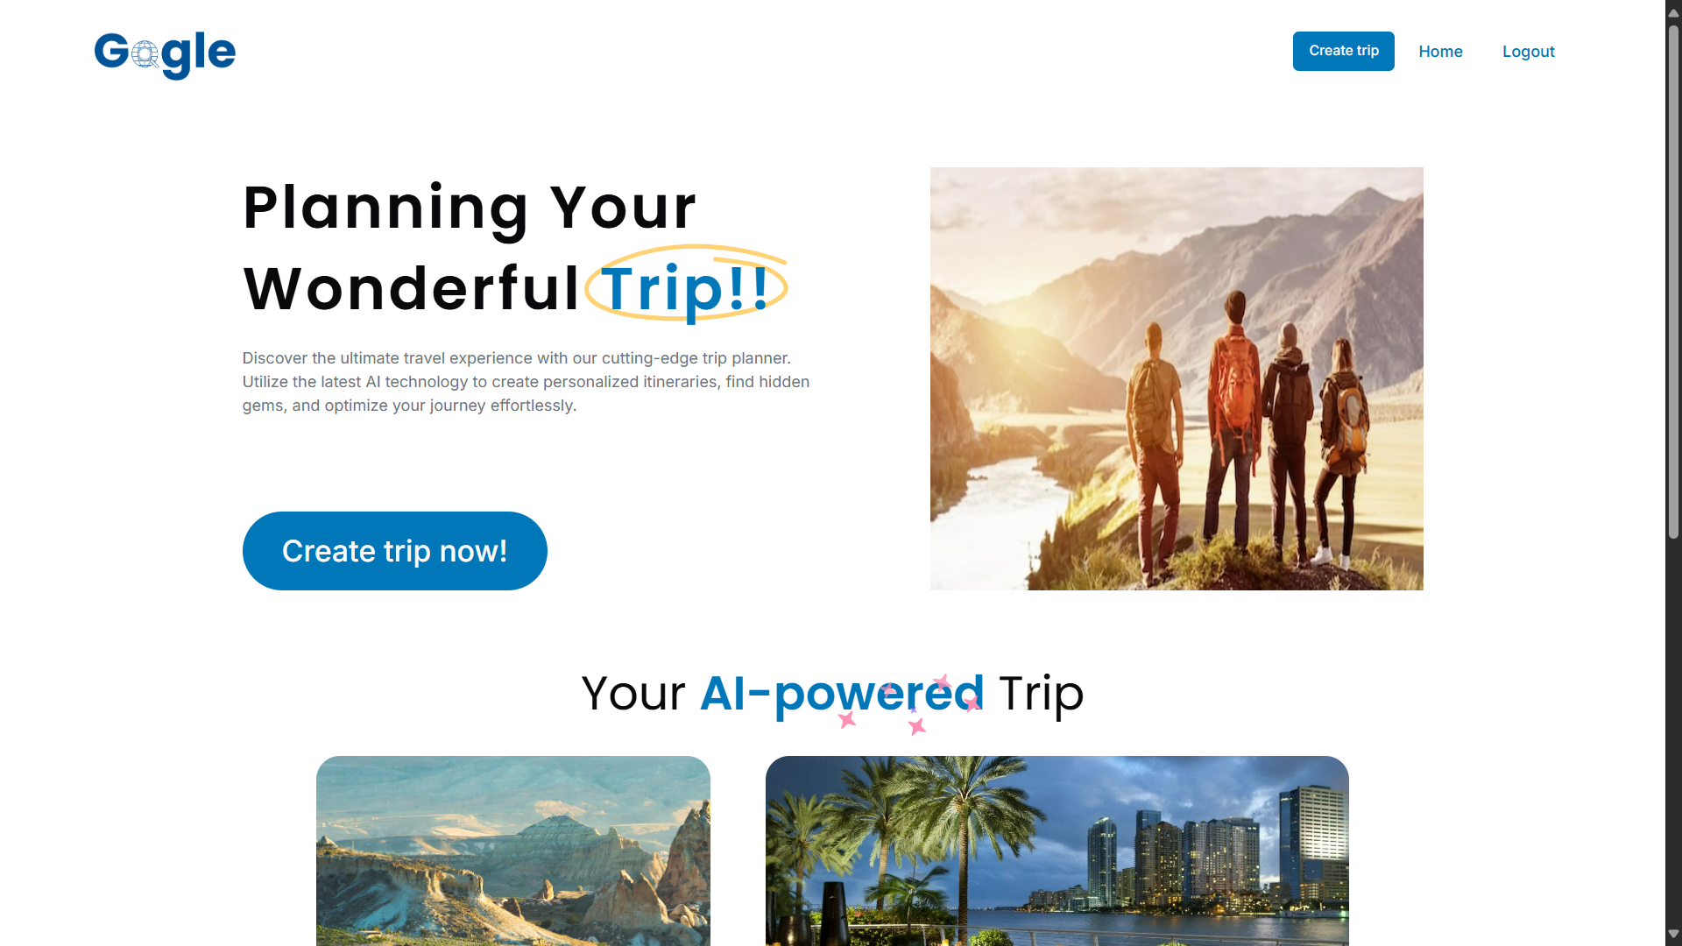
5CLCsCan
DESIGN UI
Figma is used by the Gogle team as the main tool for interface design because of its popularity and ease of use.

Slide 19
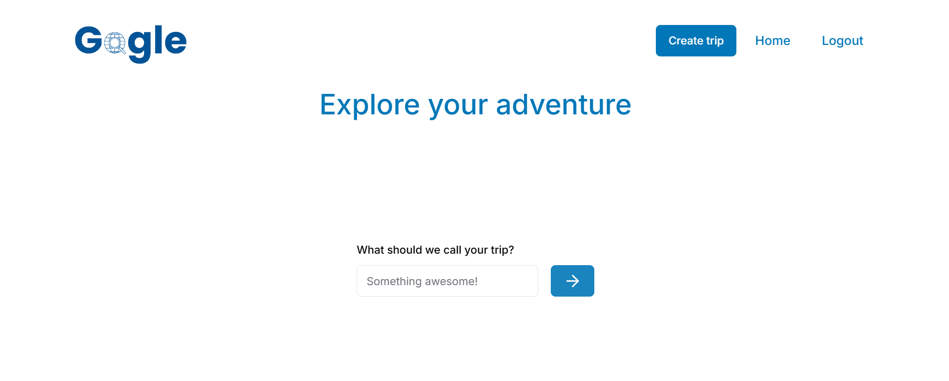
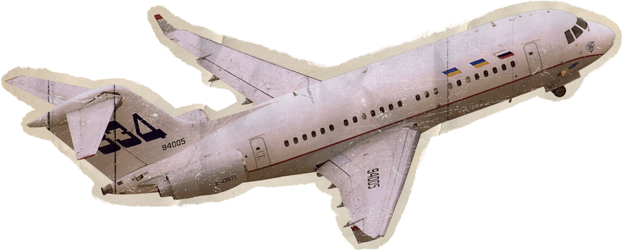
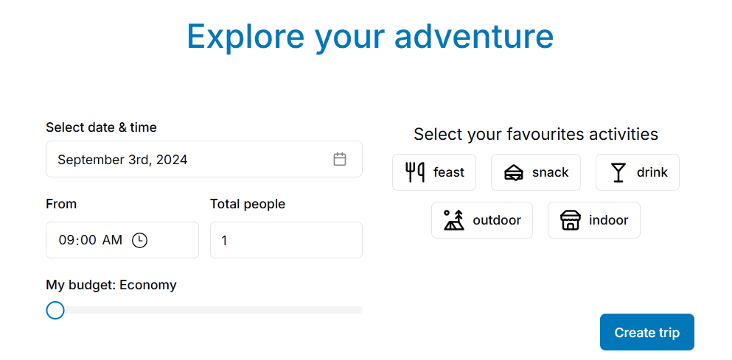
5CLCsCan

Slide 20
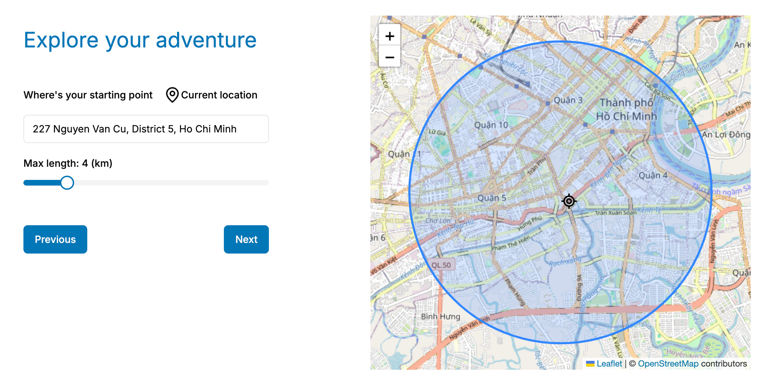
5CLCsCan

Slide 21
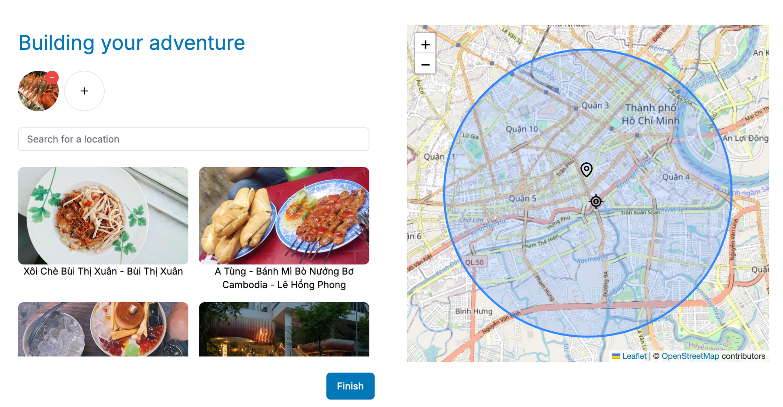
5CLCsCan

Slide 22

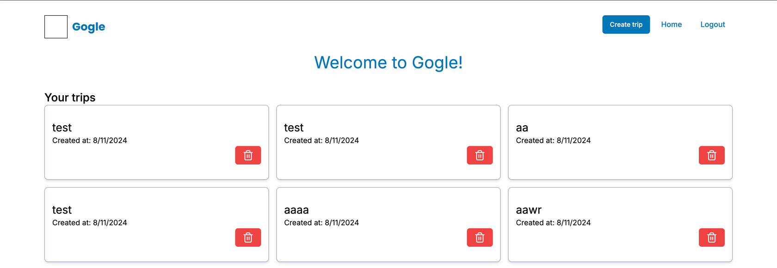



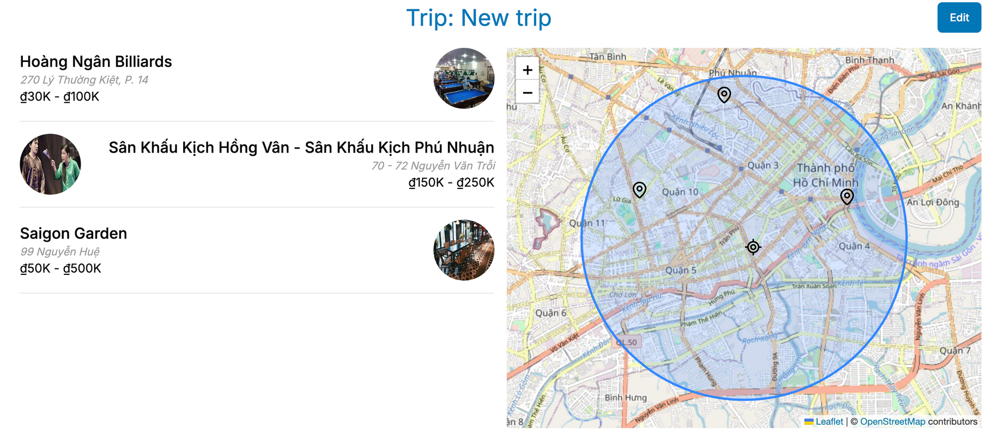

5CLCsCan

Slide 23








5CLCsCan
SOFTWARE TESTING
TESTING METHODS
SUPPORT TOOLS
Manual: Team members test the main functions and then record it via Google sheet
Google docs
Google sheet
TESTING ENVIRONMENTS
Google Chrome
Firefox
Microsoft Edge
Opera

Slide 24















Check create trip
Delete trip
T A R G E T T E S T I T E M S
View trip
Sign up
Add place
Log in
Search place

Slide 25
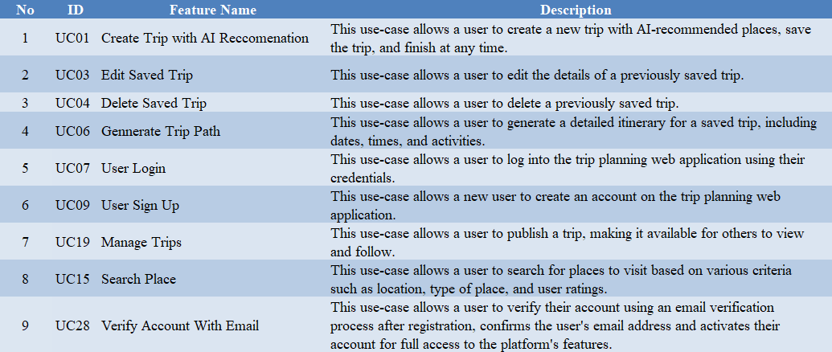

5CLCsCan
TEST PLAN
FEATURES
Number of features: 9
Number of test cases: 141
Each feature from 15-25 test cases
Each test case is tested manually.

Slide 26




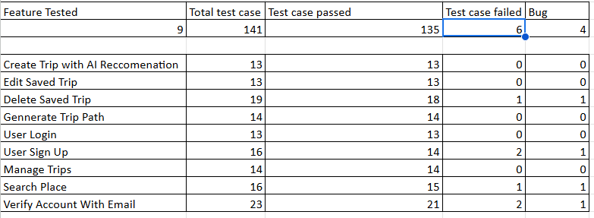
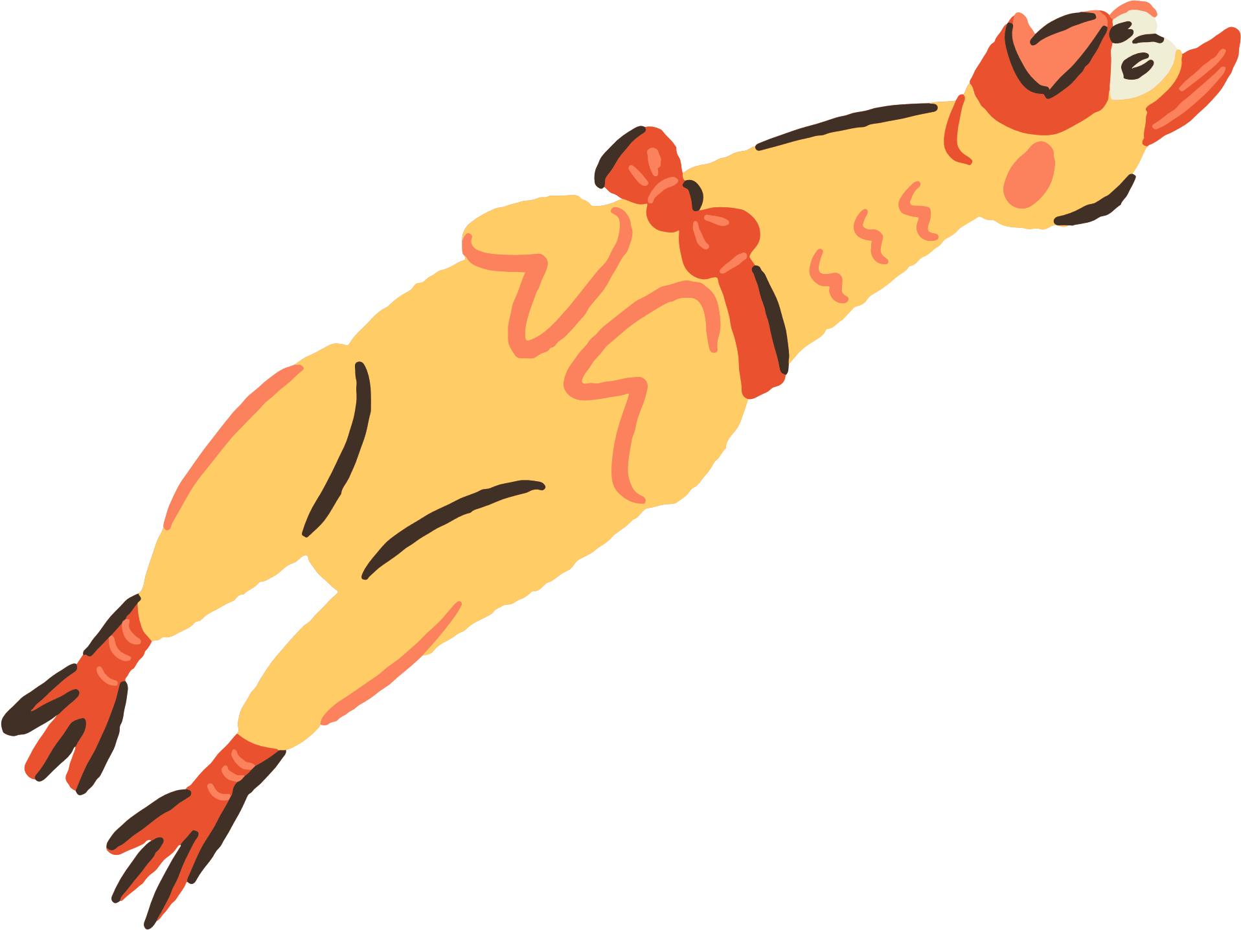
5CLCsCan
TEST SUMMARY

Slide 27

5CLCsCan
DEMO

Slide 28

5CLCsCan
THANK YOU
We sincerely appreciate your interest and willingness to support. We hope that our online marketplace and pet care service website will meet your needs and bring joy and comfort to you and your beloved furry companions. Thank you once again, and have a wonderful day!
5CLCsCan
Thesis Defense Presentation Template

